Slide 1

November Wine Tasting
Sparkling Wines
John and Ci Niznik
Lonni Wersal

Slide 2
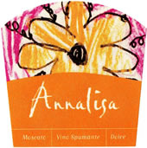
Annalisa Moscato ~ Italy
Produced by Cantina Monticelliana from selected Moscato grapes grown in Piedmont Italy. Soft and delicate with pleasantly sweet ripe flavors of apricot and peach. Ideal with fresh fruits or dessert.
Appelation: Asti Alcohol by Volume: 6.5%

Slide 3
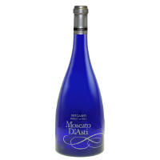
Beviamo Moscato D’Asti ~ Italy
From the Asti region of Piedmont Italy, Beviamo Moscato D'Asti will delight any wine drinker. The Moscato Bianco grapes are hand harvested and grown in a combination of limestone and sandstone soil. After harvesting, the grapes are crushed, chilled to almost freezing in stainless steel vats, fermented and bottled to capture the carbon dioxide. Made in the 'frizzante' style, this wine has a slight effervescence with flavors of pears and peaches. Pale in color and very light bodied, it is fresh and fruity with a nice touch of sweetness and a slight sparkle. It pairs well with spicy foods, chocolate and fruit based desserts. Drink well chilled on its own or with lighter dessert dishes or fresh fruit.
Alcohol by Volume: 5.5%

Slide 4
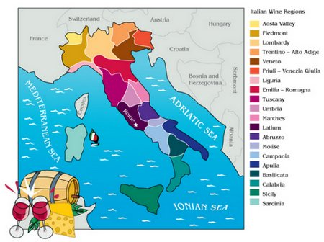
Italian Wine Regions

Slide 5

Bitch Bubbly ~ Spain
A non-vintage Rose’ Cava blend of Chardonnay, Garnacha and Viura grapes grown in the Aragon grape growing region of Spain. Pale strawberry in color with a vibrant nose of sweet strawberries and raspberries with some toffee notes. Fresh berries, sweet candy and citrus on the palate with a long, luscious creamy finish.
Alcohol by Volume: 11%

Slide 6
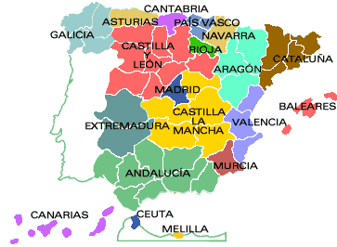
Spanish Wine Regions

Slide 7
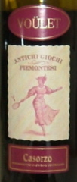
2011 Fra Voulet Casorzo ~ Italy
Fracchia Voulet Casorzo Sweet Malvasia Rosso is a fun, fizzy, sweet red wine from the northwest of Italy. Serve this treat cold after dinner, or just sip it on its own. One of our best selling wines! Like a sophisticated lambrusco, this wine is redolent of bright red fruit, and leaves a pleasant tinge on the tongue-- all with no syrupy or saccharine qualities.
Alcohol by Volume: 5%

Slide 8
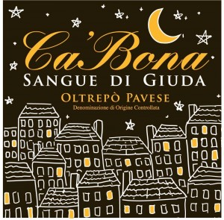
2009 Ca’ Bea Sangue di Giuda ~ Italy
This fun frizzante dolce wine is made from 25% Croatina, 30% Barbera and 45% Uva Rara. From the Lombardia Region of Italy. It’s floral and bright with scents of fresh red fruit and spice. The flavors dance off the palate from the light bubbles making in totally refreshing and enjoyable. Perfect for after dinner with some chocolate or just to sip on a hot summer afternoon.
Appelation: Oltrepo Pavese Alcohol by Volume: 7.3%

Slide 9
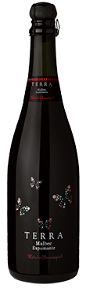
2009 Terra Sparkling Malbec ~ Argentina
100% Malbec grapes from vineyards at Lujan de Cuyo, Mendoza, 1020 meters above sea level. This area is characterized by warm days and cold nights, bringing fruit to complete maturity and excellent flavor concentration. The grapes are harvested manually in plastic boxes in mid February , early in the morning avoiding the heat of the day.
This sparkling wine is made using the “Chaussepied Method”, has French origin and permits to carry out the process in small casks of 3 – 4 thousands litters that allow the control and management of volumes with the idea that if quantity is slower, quality increases, after 45 days and having reached a pressure of 5 atm, the wine is bottled. Wine is fermented in stainless steel tanks for 2 weeks. Later placed in stainless steel tanks with temperature control and expedition liquor (addition of sugar) with yeast addition to allow the second fermentation, which is controlled and stops when pressure reaches 5 atm and residual sugar of 15 g/l.
Intense red with blue tones and a very bright, giving origin to violet bubbles. Red fruits in nose, cranberry, plums, and a touch of toasted bread and almond, which are the typical red wine aromas. It has a balanced acidity and sugar. Adorned with red fruits, a lot of greasiness and tannins that give a firm structure which characterizes the Malbec Wine.
Alcohol Volume: 12.5%

Slide 10
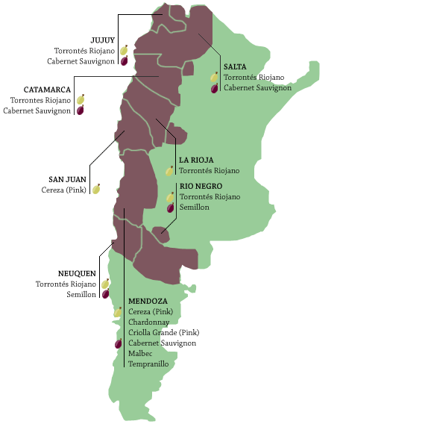
Argentina Wine Regions

